Slide 1
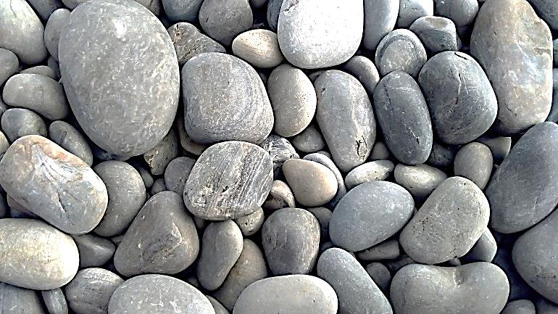

GALLSTONE DISEASE
Prof.Dr.Ahmet Dobrucalı
İÜ.Cerrahpaşa Tıp Fakültesi
Gastroenteroloji Bilim Dalı

Slide 2
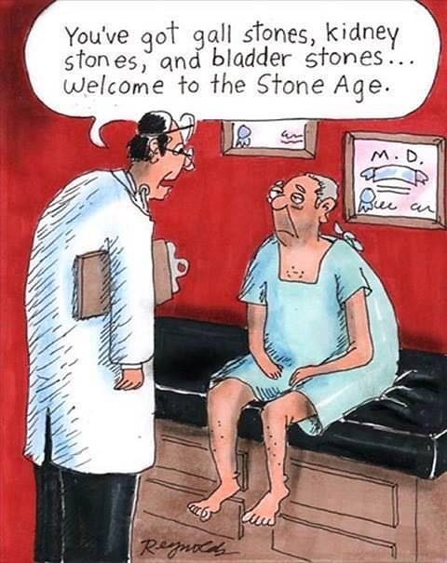

Slide 3
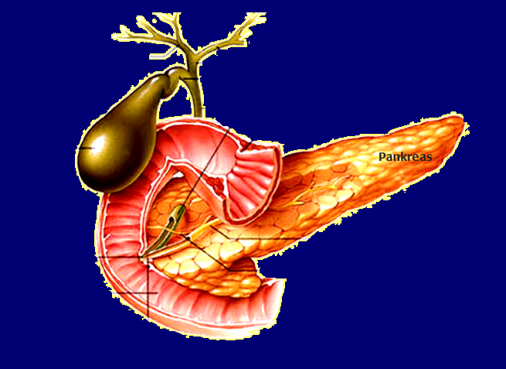
Right main bile duct
Left main bile duct
Ductus cysticus
Choledoc
Gall bladder
Wirsung’s duct
Vater’s ampulla
Santorini’s duct
Duodenum
Oddi’s sphincter
İÜ.Cerrahpaşa Tıp Fakültesi
Gastroenteroloji Bilim Dalı

Slide 4

Composition of bile
Water (%85-95)
Organic compounds Proteins
Bilirubin
Cholesterol Phospholipids (Lecithin 85%) Bile acids
Inorganic compounds
Electrolytes

Slide 5
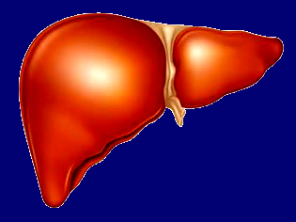
Cholesterol
Primary bile salts
Cholic acid
Chenodeoxycholic acid
Enterohepatic circulation
Intestinal bacteries
Secondary bile salts
Deoxycholic acid
Lithocholic acid

Slide 6
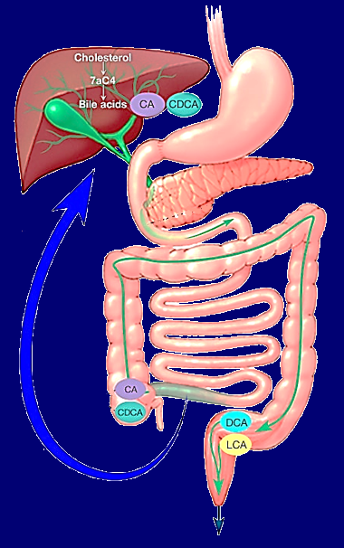
Enterohepatic Circulation of bile acids
Bile acids emulsify dietary
fats
Liver produces 500mg bile salts and 500-600ml bile per day
During fasting, bile resides in the gallbladder and concentrated up to ten fold
90% of bile salts absorbed from terminal ileum and enter the portal circulation
The bile acid pool cycles through the enterohepatic circulation 2 to 4 times per meal (4 - 12 / day)
600mg of bile acids are excreted in stool per day.
Negative feedback inhibition of bile acid synthesis
CCK
5-10% remains in colon
90-95% reabsorbed
2017 MAYO
İÜ.Cerrahpaşa Tıp Fakültesi
Gastroenteroloji Bilim Dalı
5% excreted in stool

Slide 7
Nomenclature
Gallstones ------------------- Cholecystolithiasis
Bile duct stones --------------- Choledocholithiasis
Gallbladder inflammation ---------------- Cholecystitis
Bile duct inflammation ---------------- Cholangitis
Gallbladder inflammation with gallstone ------- Calculous cholecystitis
Gallbladder inflammation without gallstone --------- Acalculous cholecystitis
İÜ.Cerrahpaşa Tıp Fakültesi
Gastroenteroloji Bilim Dalı

Slide 8
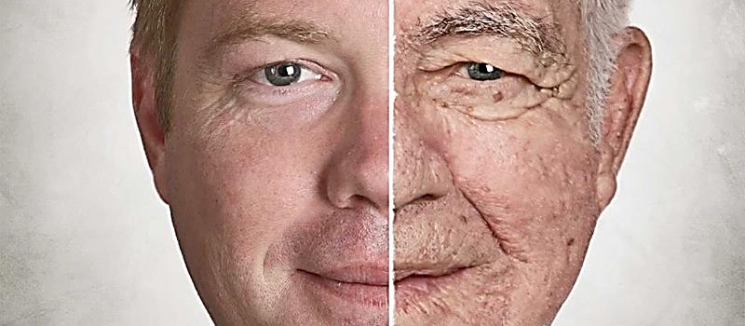
Incidence
10-15%
F/M :2
50%
10-15% of adults in western societies have gallstones (F/M: 2).
30% of women in their sixties and 50% of women and men in their eighties have bile sludge (or gallstone).
Pregnancy (especially multiparity) is a wellknown risk factor for gallstone development.
- It is usually onset in 2. and 3. trimestr and asymptomatic.
- Cholcystitis is the second most common reason for surgery in pregnancy
after acute appendicitis.
- In postpartum period, ¼ of women have bile sludge and 5% have
gallstone. During the first five years after the delivery, women have high risk
for gall stone formation.
İÜ.Cerrahpaşa Tıp Fakültesi
Gastroenteroloji Bilim Dalı

Slide 9
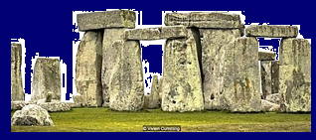
According to stone type:
- Cholesterol stones
- Pigment Stones
According to stone localization;
- Cholecystolithiasis
- Choledocholithiasis
According to clinical presentation:
- Asymptomatic
- Acute
- Chronic
- Complicated bile stone disease
İÜ.Cerrahpaşa Tıp Fakültesi
Gastroenteroloji Bilim Dalı

Slide 10
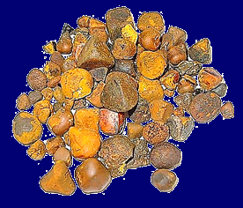
Cholesterol stones
Cholesterol stones contain 60-90% cholesterol by weight plus minor proportions of glycoprotein matrix, calcium and bilirubin.
70-90% of gallbladder stones are cholesterol stones
In western populations, cholesterol gallstones may be found in about 15-20% of women and 10-15% of men.
The incidence in North and South American indians approaches 70% to 90%.
İÜ.Cerrahpaşa Tıp Fakültesi
Gastroenteroloji Bilim Dalı

Slide 11
Risk factors for development of cholesterol stones
Aging (>70)
Female gender (x 2-3)
Multiparity
Obezity
Rapid weight lose
Etnisity (70% of young Pima Indian women and 50% of scandinavian women over 50)
Chronic gallbladdder stasis
Medications (Ceftriaxone, oral contraseptive, octreotide and ve cholestyramine )
Hypertrigliseridemia
Diseases of the terminal ileum (Crohn’s disease, terminal ileum resection more than 80-100 cm)
İÜ.Cerrahpaşa Tıp Fakültesi
Gastroenteroloji Bilim Dalı

Slide 12
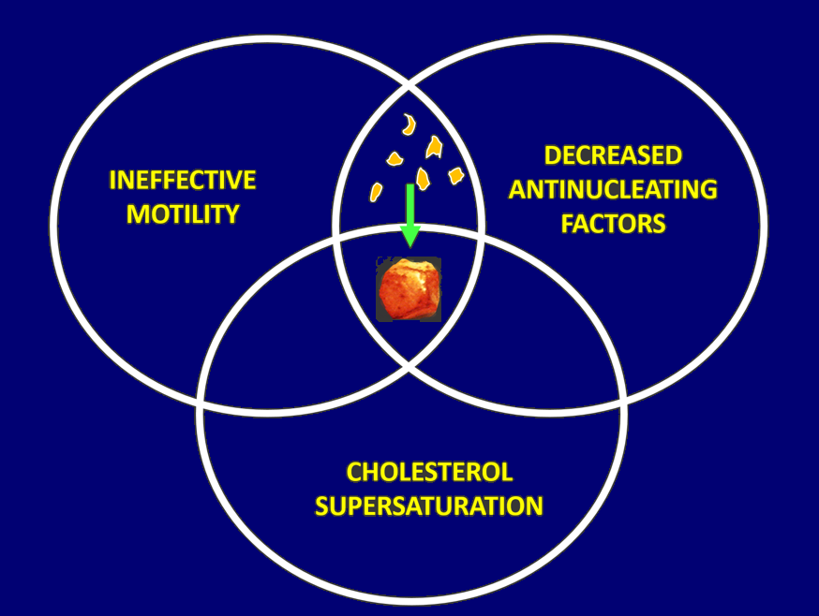

Pathophysiology of cholesterol stones
In 30-40% of patients with gallstone disease have delayed gallbladder emptying
Distorbed balance between the preventive and facilitative factors of nucleation in chrystal formation

Slide 13
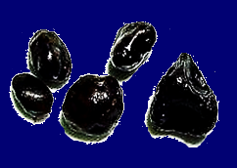
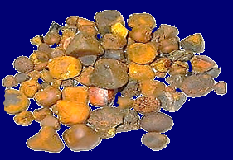
Pigment stones
They nearly constitute 10-30 percent of the gallbladder stones
There are two types of pigment stones;
and
Black
Brown
İÜ.Cerrahpaşa Tıp Fakültesi
Gastroenteroloji Bilim Dalı

Slide 14
Pigment stones
 | Black stones | Brown stones
Primary location | Gallbladder | Bile ducts
Frequency | 20% of gallbladder stones | 50% of bile duct stones
Morphology | Small, hard, black, round or irregular | Small to large, brown, softer
Content | Calcium bilirubinate polymer and other salts, less than 10% cholesterol | Calcium bilirubinate, fatty acids, 10-30% cholesterol
Setting | Mostly idiopathic Increasing age Cirrhosis (Alcoholic) Chronic hemolysis | Chronic stasis and infection Strictures Biliary parasites
İÜ.Cerrahpaşa Tıp Fakültesi
Gastroenteroloji Bilim Dalı

Slide 15
Risc factors in pigment stones formation
Chronic haemolysis
Alcoholic cirrhosis
Advanced age
Terminal ileum disease, resection or bypass
Biliary infection
Bile duct stenosis
Duodenal diverticula
Chronic gall bladder stasis
Truncal vagotomy
Hyperparathyroidism
Primary biliary cirrhosis
>90%
İÜ.Cerrahpaşa Tıp Fakültesi
Gastroenteroloji Bilim Dalı

Slide 16
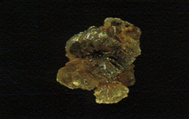
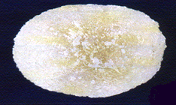
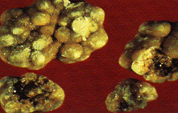
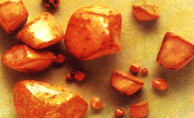
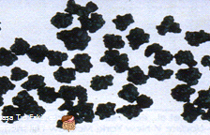
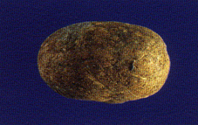
Cholesterol
stone
Cholesterol stone
Pigment
stones
Multifaced cholesterol stones
Pigment
stones
Cholesterol
stone

Slide 17
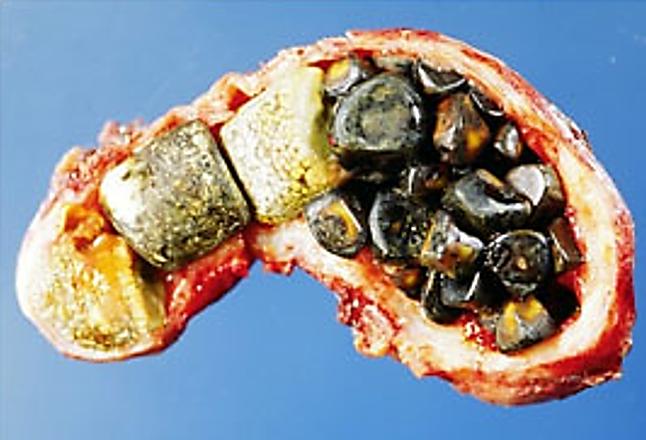
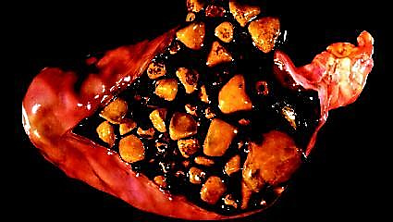
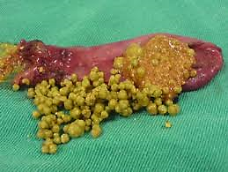
İÜ.Cerrahpaşa Tıp Fakültesi
Gastroenteroloji Bilim Dalı

Slide 18
Clinic
Asymptomatic cholelithiasis
Acute calculous cholecystitis
Chronic calculous cholecystitis
Acute or chronic acalculous cholecystitis
İÜ.Cerrahpaşa Tıp Fakültesi
Gastroenteroloji Bilim Dalı

Slide 19
Asymptomatic cholecystolithiasis
80% of gallstones are asymptomatic over the long term.
The probability of developing symptomatic disease 15% at ten years and 18% at twenty years. Acute cholecystitis and other severe events are an initial occurence in only 3% of patients.
Once gallstones have been identified, their relation to nonspesific dyspeptic symptoms and food intolerence becomes problematic.
İÜ.Cerrahpaşa Tıp Fakültesi
Gastroenteroloji Bilim Dalı

Slide 20

Acute calculous cholecystitis
Most commonly occurs in the presence of gallbladder stones.
There is a gradually increasing pain in the right upper quadrant and/ or epigastrium. Pain may radiate to right shoulder and back. Usually it is not a colic.
Nausea and vomiting usually occur. Mild to moderate fever with chill may present.
Jaundice is occasionally present as a result of local hepatic inflammation or ductal edema. It should raise suspicion for concurrent bile duct stones.
İÜ.Cerrahpaşa Tıp Fakültesi
Gastroenteroloji Bilim Dalı

Slide 21
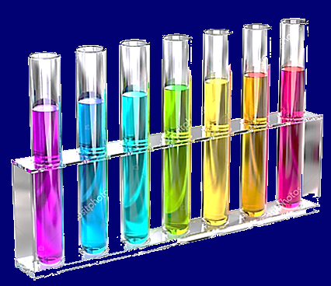
Laboratory studies supportive but nonspesific.
A moderate leukocytosis and CRP elevation are usually present. Mild elevation of amylase and liver enzymes are often seen, but marked elevation should prompt evaluation for duct stones.
Hyperbilirubinemi associated with elevated serum alkalen phosphatase and GGT indicates the presence of a duct stone and/or cholangitis.
High serum amylase levels (>500 U) should rise suspicion of a biliary pancreatitis.
İÜ.Cerrahpaşa Tıp Fakültesi
Gastroenteroloji Bilim Dalı

Slide 22

Gallstones without cholecystitis may produce pain caused by intermittent obstruction of the cystic duct by a stone.Usually begins abrubtly after a fatty meal and resolves gradually within 3 hours. Prolonged pain (>3h) should rise suspicion of a complication such as cholecystitis, cholangitis or pancreatitis.
İÜ.Cerrahpaşa Tıp Fakültesi
Gastroenteroloji Bilim Dalı

Slide 23
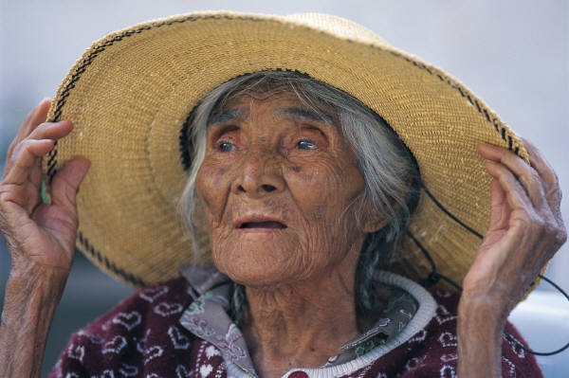
Atypical presentations that occur particularly in elderly and debilitated patients include painless jaundice or leukocytosis and fever of unknown origin.
!!!
İÜ.Cerrahpaşa Tıp Fakültesi
Gastroenteroloji Bilim Dalı

Slide 24
Murphy’s sign is usually positive in physical examination. Murphy ’s sign is the presence of tenderness and respiratory guarding during palpation of the right upper quadrant.
Up to one-third of patients may have a palpable gallbladder (Hydrops vesicalis)
Gallbladder may not be palpable in the patients with chronic cholecystitis and gallbladder cancer.
İÜ.Cerrahpaşa Tıp Fakültesi
Gastroenteroloji Bilim Dalı

Slide 25
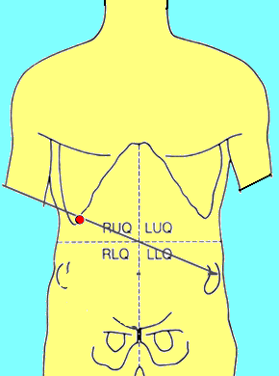
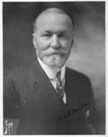
John B Murphy
(1857-1916)
Murphy’s points

Slide 26
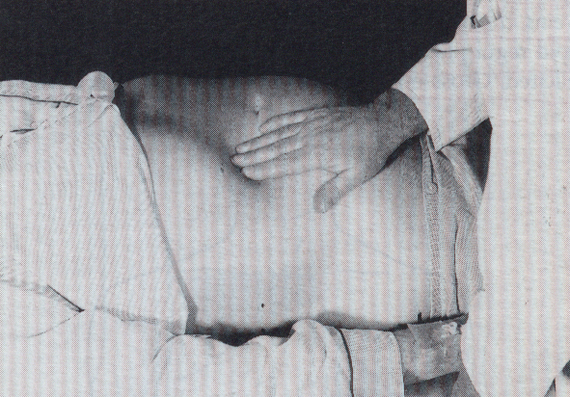
Murphy’s maneuvre and rough percussion
When right upper quadrant pain and tenderness suggest acute cholecystitis, look for Murphy’s sign and rough percussion over the costal margin.
İnspiration
İÜ.Cerrahpaşa Tıp Fakültesi
Gastroenteroloji Bilim Dalı

Slide 27
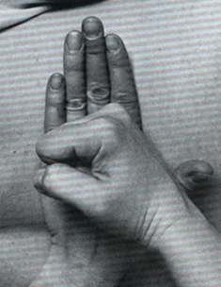
Murphy’s maneuvre and rough percussion
When right upper quadrant pain and tenderness suggest acute cholecystitis, look for Murphy’s sign and rough percussion over the costal margin.
İÜ.Cerrahpaşa Tıp Fakültesi
Gastroenteroloji Bilim Dalı
Rough percussion

Slide 28
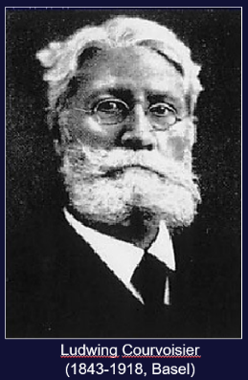
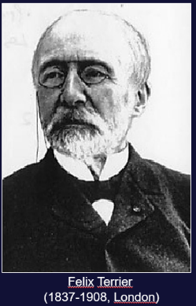
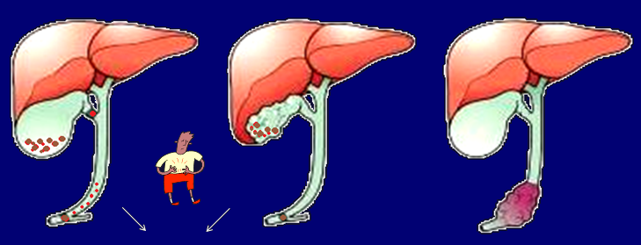
Courvoisier & Terrier rule
Jaundice +/- Jaundice +/- Jaundice +
Cholecystitis, cholelithiasis, choledocholithiasis
Tumors orginating from pancreas, ampulla Vateri, periampuller region
and choledoc
İÜ.Cerrahpaşa Tıp Fakültesi
Gastroenteroloji Bilim Dalı

Slide 29
Chronic calculous cholecystitis
Most commonly occurs in the presence of chronic gallbladder stones.
Usually presents as recurrent episodes of biliary pain.This is a rapidly developing steady epigastric or right upper quadrant pain, typically lasting from 15 minutes to 6 hours.Pain may radiate to chest, neck, shoulder and back.
Sweating, nausea and womiting may be associated symptoms
During acute episode, physical examination may be normal or may show mild or remarkable right upper quadrant tenderness . Between episodes the examination is normal. Murphy’s sign usually negative. Rough percussion may be helpful.
A mild to moderate leukocytosis and mild elevations in liver and pancreas enzymes and CRP may present.
İÜ.Cerrahpaşa Tıp Fakültesi
Gastroenteroloji Bilim Dalı

Slide 30
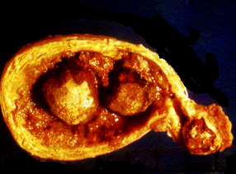
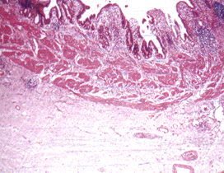
Gall stones
Thickened gallbladder wall
Mucosa
Thick muscle coat
Clusters of chronic inflammatory cells
Fibrozis of the serosal aspect
İÜ.Cerrahpaşa Tıp Fakültesi
Gastroenteroloji Bilim Dalı

Slide 31
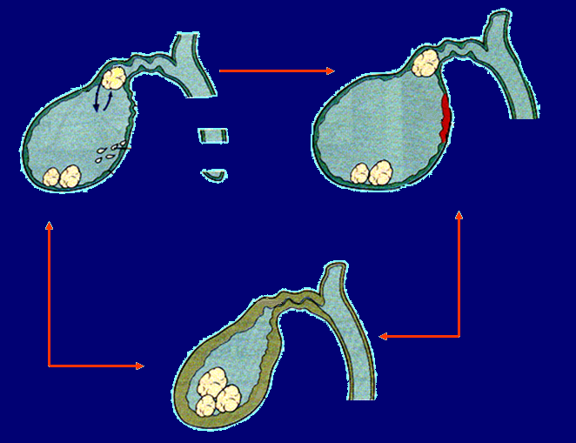
Biliary colic
Acute cholecystitis
Stone impaction
Persistent obstruction
Gallbladder spasm
Edematous and acutely inflamaed gallbladder
Mucosal secretion
Galbladder distention (pain)
Ischemia, necrosis
Chronic cholecystitis
Occasionally, scarred occludede cystic duct
Smal contracted gallbladder with thickened scarred mucosa
İÜ.Cerrahpaşa Tıp Fakültesi
Gastroenteroloji Bilim Dalı

Slide 32
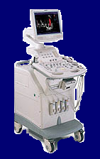
Acalculous cholecystitis
Clinical and laboratory findings show marked similarity with calculous cholecystitis.
Abdominal pain, leukocytosis, mild fever and mild to moderate elevation of liver enzymes are present in most patients.
US and CT are first choices in diagnosis
- Bile sludge in gallbladder - Hydropic gallbladder - Thickened gallbladder wall - Ultrasonographic Murphy
İÜ.Cerrahpaşa Tıp Fakültesi
Gastroenteroloji Bilim Dalı

Slide 33
Acalculous cholecystitis (10%)
Trauma, major surgeries and AMI etc.
Long standing hospitalization in intensive care units
Long standing parenteral feeding
Chronic narcotic abuse
Sepsis
Bile sludge in gallbladder
Ischemia due to poor gallbladder perfusion
Bacteriemia
Impaired gallbladder emptying
Hyperconcentration of bile in gallbladdder
?
İÜ.Cerrahpaşa Tıp Fakültesi
Gastroenteroloji Bilim Dalı

Slide 34
Complications of gallstones
Some complications may develop in 10% of patients with gallstone disease;
-Pancreatitis
- Perforation
- Cholecystoenteric fistula
- Bilestone ileus
- Emphysematous cholecystitis
- Sepsis
- Mirizzi’s syndrome
- Porcellain gallbladder
İÜ.Cerrahpaşa Tıp Fakültesi
Gastroenteroloji Bilim Dalı

Slide 35
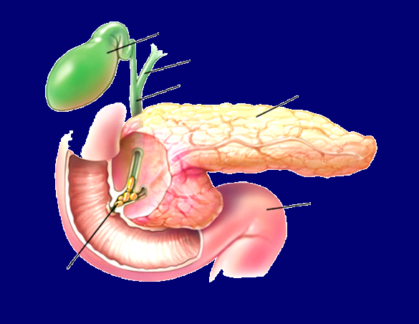
Biliary pancreatitis
Gallbladder
Main bile ducts
Choledoc
Pancreas
Duodenum
Impacted bile stones in ampulla
İÜ.Cerrahpaşa Tıp Fakültesi
Gastroenteroloji Bilim Dalı

Slide 36

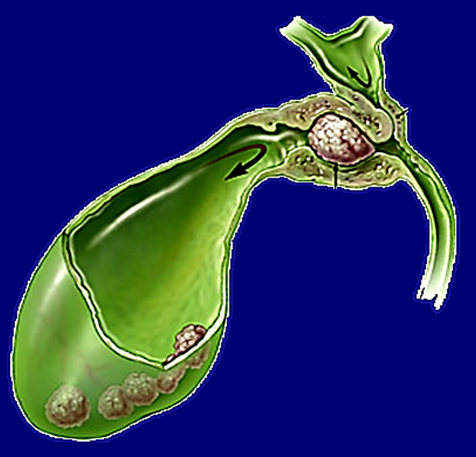
Mirizzi’s syndrome
Dilated hepatic duct
Inflammation causes obstruction
Impacted calculus in cystic duct
Hydropic gallbladder
İÜ.Cerrahpaşa Tıp Fakültesi
Gastroenteroloji Bilim Dalı

Slide 37
Cholecystoenteric fistula and gallstone ileus
Cholecystoenteric fistulas (CEF) are typically seen in persons 65-75 years of age.
The most common location of CEF is duodenum (Bouveret’s syndrome) followed by the colon,stomach and jejunum.
The most common site of gallstone impaction is in the terminal ileum or ileocecal valve.
Many patients with gallstone ileus may have serious concomitant medical ilness. Delayed diagnosis leads to high mortality rate (50%).
Pneumobilia (air in the biliary tree) and dilated small bowel loops on direct abdominal X-ray are suggestive for gallstone ileus.
İÜ.Cerrahpaşa Tıp Fakültesi
Gastroenteroloji Bilim Dalı

Slide 38
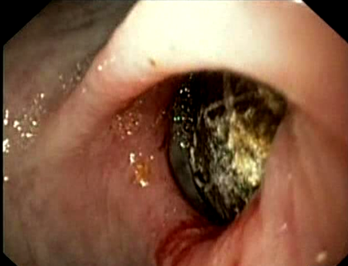
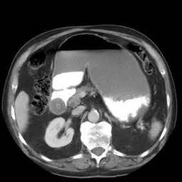
Cholecystoenteric fistula and gallstone ileus
Endoscopy CT
İÜ.Cerrahpaşa Tıp Fakültesi
Gastroenteroloji Bilim Dalı

Slide 39
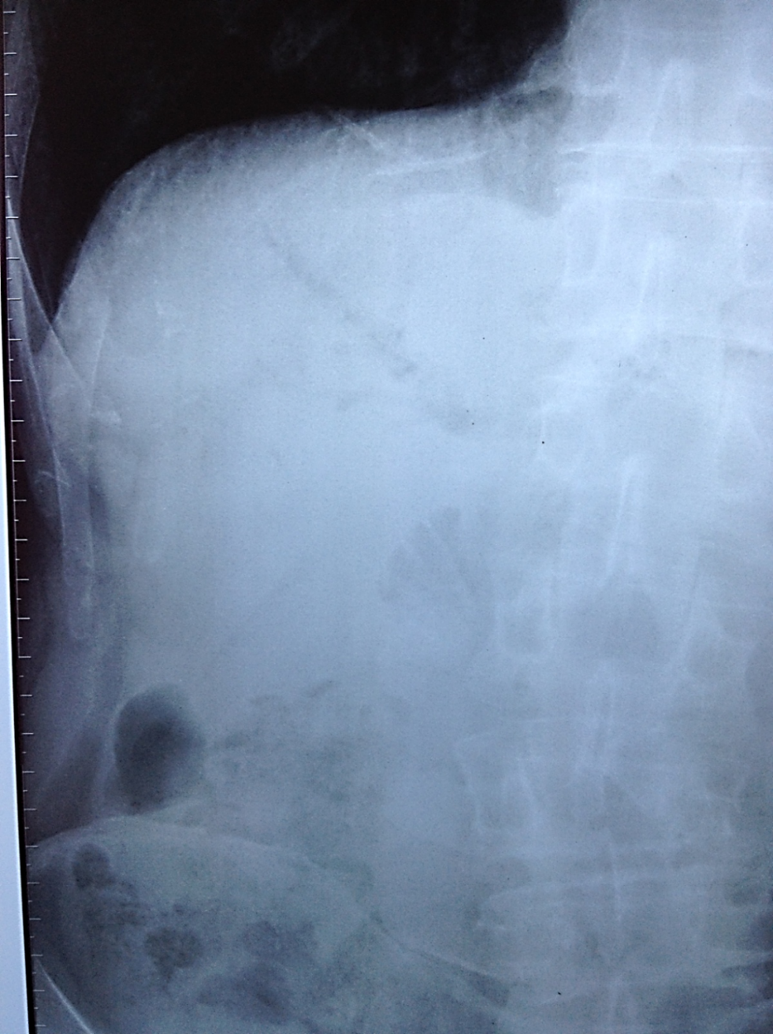
Pneumobilia
İÜ.Cerrahpaşa Tıp Fakültesi
Gastroenteroloji Bilim Dalı

Slide 40
Porcellain gallbladder (PG)
PG is defined as intramural calcification of the gallbladdder. It is not a complication of gallstones.
It is associated with an increased risk of gallbladder carcinoma which can occur in 20% of patients.
Development of cancer depends on the pattern of gallbladder wall calcification. Selective mucosal calcification causes significant cancer risk.
Patients are usually asymptomatic and laboratory test are normal.
Prophylactic cholecytectomy is indicated to prevent gallbladder carcinoma
İÜ.Cerrahpaşa Tıp Fakültesi
Gastroenteroloji Bilim Dalı

Slide 41
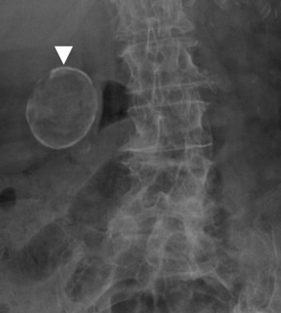
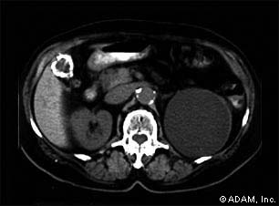
Porcellain gallbladder (PG)
CT
Direct X ray
İÜ.Cerrahpaşa Tıp Fakültesi
Gastroenteroloji Bilim Dalı

Slide 42
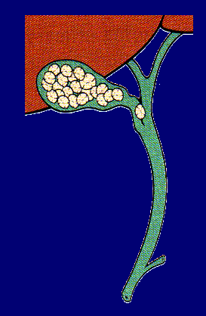
Bile duct stones (Choledocholithiasis)
Primary bile duct stones - Orginate in ducts - Usually brown pigment
- Associated with strictures, infection,stasis and
chronic biliary obstruction
Secondary bile duct stones - Orginate in gallbaldder
- Cholesterol or black pigment composition same as
concurrent or prior gallbladder stones
10-15% of patients undergoing cholecystectomy for gallbladder stones have concurrent duct stones.
İÜ.Cerrahpaşa Tıp Fakültesi
Gastroenteroloji Bilim Dalı

Slide 43
Clinical presentation
Symptoms vary from chronic asymptomatic to recurrent biliary colic, jaundice or cholangitis. An acute biliary pancreatitis may be a first symtom of formerly asymptomatic duct stone or sludge.
Right upper quadrant pain + fever + Jaundice
Charco‘ s triad.
It is a typical finding for cholangitis
İÜ.Cerrahpaşa Tıp Fakültesi
Gastroenteroloji Bilim Dalı

Slide 44
Associated jaundice and laboratory abnormalities may follow a fluctuating course. Serum bilirubin, alkaline phosphatase are less marked than fixed malignant obstruction. In chronic cases, an elevated alkaline phosphatase may be the only indicator of biliary obstruction.
In the case of an acute cholangitis, transaminases may reach marked elevations of 500 U/ml or more with a rapid decline over 2-3 days after therapy.
Causative organisms are most commonly enterobacteriacea (E.Coli, Klesbsiella spp.), streptococcus or anaerobic organisms.
Physical examination may show right upper quadrant tenderness and gallbladder may be palpabl (hydropic). Rough percussion of right hypochondrium is allways positive.
İÜ.Cerrahpaşa Tıp Fakültesi
Gastroenteroloji Bilim Dalı

Slide 45
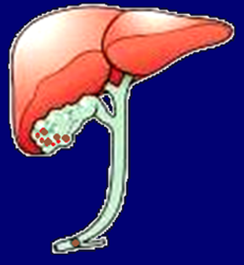
Predictors of bile duct stones
Predictors
Very strong
Ascending cholangitis
Common bile duct stone on abdominal
ultrasonography
Bilirubin > 4 mg/dL
Strong
Dilated common bile duct on abdominal
ultrasonography
Bilirubin 1.8–4 mg/dL
Moderate
Age > 55
Abnormal aminotransferase and
gamma-glutamyl transferase levels
Gallstone pancreatitis
Likelihood of choledocholithiasis
based on predictors
High (> 50%)
Presence of any very strong factor
Presence of 2 strong factors
Intermediate (10% to 50%)
All other patients
Low (< 10%)
No predictors present
İÜ.Cerrahpaşa Tıp Fakültesi
Gastroenteroloji Bilim Dalı

Slide 46
Complications of gallstone disease
Recurring biliary colic and jaundice attacks
Pancreatitis
Acute pyogenic cholangitis
Chronic cholangitis and stricture formation
Seconder biliary cirrhosis
Cholangiocarcinoma
Liver abbcess
Portal vein thrombosis
Sepsis
DIC
Acute renal failure
!
Reynold’s pentad; Fever + Jaundice + Pain + Hypotension + Lethargy

Slide 47
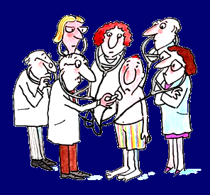
Diagnosis of gallstone disease
Dr. Büşra
Dr. Selim
Direct abdominal x-ray
Ultrasonography
Cholesintigraphy
CT
MRCP
ERCP
Dr.Burak
Dr. Furkan
Dr. Enginar
İÜ.Cerrahpaşa Tıp Fakültesi
Gastroenteroloji Bilim Dalı

Slide 48
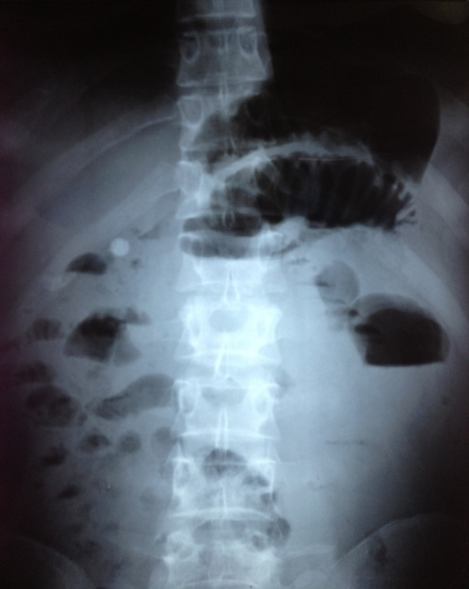
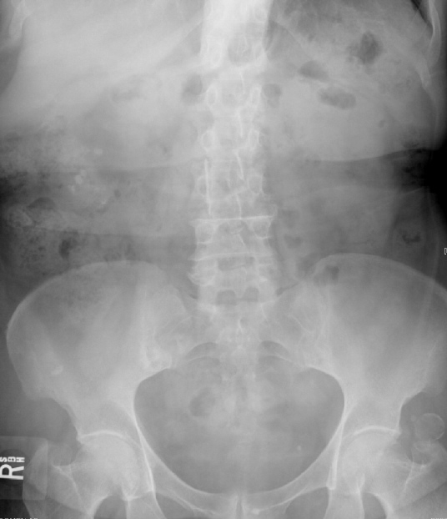
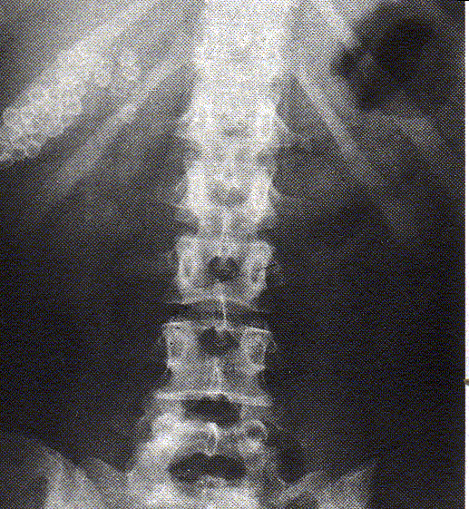
Direct abdominal X-ray
Because of calcium content, bile stones may be visible on direct abdominal X-ray in 10-15 percent of patients.

Slide 49
Ultrasonography
US is primary tool for diagnosing biliary stone disease
Advantages of US; no radiation, non-invasive, cheap and portabl.
It has high sensitivity (90-95%) and spesivity (90-98%). Sensitivity is lover in bile duct stones (50%).
In US it is possible to evaluate the other organs beside liver and bile ducts.
US may detect the particules as small as 1mm
Radiologist may perform a ‘Murphy maneuver’ during ultrasonograpy.

Slide 50
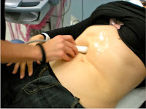
Ultrasonographic findings of acute cholecystitis
Presence of gallstone in gallbladder
Thickening of gallbladder wall (>4mm)
Thickening of gallbladder also seen in; Portal hypertension, ascites,
hypoalbuminemia and right heart failure
Pericholecystic fluid accumulation
Positive Murphy test during ultrasonography
Ultrasonographic Murphy

Slide 51
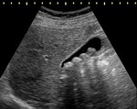
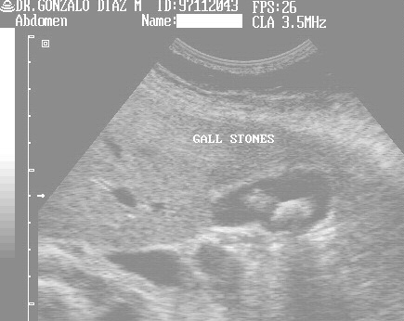
Ultrasonographic findings of acute cholecystitis
Gallbladder
Stones
Acoustic shadows

Slide 52
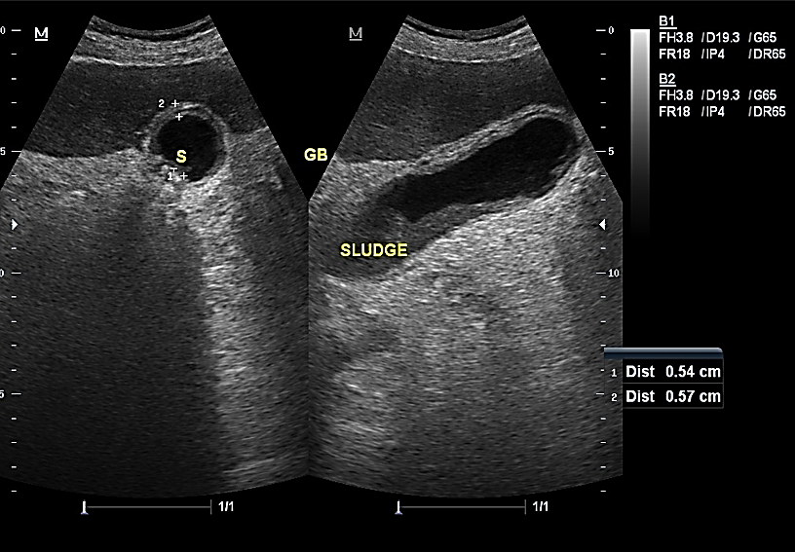
İÜ.Cerrahpaşa Tıp Fakültesi
Gastroenteroloji Bilim Dalı

Slide 53

İÜ.Cerrahpaşa Tıp Fakültesi
Gastroenteroloji Bilim Dalı

Slide 54
Cholescintigraphy
^{99m}Tc HIDA (Hydroxy- Hepato-iminodiacetic acid ), PIPIDA (Paraisoprpyl iminodiacetic ecid)
In normal condition, gallbladder must visualised in 30-60 min after iv injection of radionuclid marker. Nonvisualization of the gallbladder after 4 hours is indicative of cystic duct obstruction due to cholecystitis.
Sensitivity and spesivity are more than 90% in acute calculous cholecystitis . Concurrent using of morphin (0.04mg/kg iv) may increas the sensitivity of test.
False negativity may occur in acalculous cholecystitis and false positivity may occur in chronic cholecystitis, chronic liver disease and during parenteral nutrition
İÜ.Cerrahpaşa Tıp Fakültesi
Gastroenteroloji Bilim Dalı

Slide 55


^{99m}Tc HIDA Cholescintigraphy
Visible gallbladder
No visual gallbladder
Gallbladder is not seen
Small intestines

Slide 56
C T (Computed tomography)
CT has little role in the diagnosis of cholelithiasis because many stones are isodence with bile and therefore not identified.
Bile stones look as hyperecogen particules on CT. Gallbladder thickening, pericholecystic fluid collections, free air and abscess may seen.
Main disadvantages of CT; Expensive, radiation and nonportabl
During the evaluation of fever, jaundice or atypical abdominal pain CT often provides the first indication for evaluating of complications in acute cholecystitis.
İÜ.Cerrahpaşa Tıp Fakültesi
Gastroenteroloji Bilim Dalı

Slide 57



C T (Computed tomography)
İÜ.Cerrahpaşa Tıp Fakültesi
Gastroenteroloji Bilim Dalı

Slide 58

Gallbladder with tickhened and oedematous wall
Stone in gallbladder
CT

Slide 59

İÜ.Cerrahpaşa Tıp Fakültesi
Gastroenteroloji Bilim Dalı

Slide 60

MRCP (Magnetic resonance cholangiopancreatogrphy)
MRCP is not a primary diagnostic tool for diagnosis of bile stones. It is more useful for the evaluation of bile ducts rather than gallbladder.
Sensitivity of MRCP in detecting of bile duct stones is over 90%. Sensitivity is lover in the presence of small duct stones (<5mm).
MRCP is generally the test of choice when the suspicion for choledocholithiasis is low or intermediate
Advantage: No radiation
Disadvantage: Expensive , clostrofobia !
İÜ.Cerrahpaşa Tıp Fakültesi
Gastroenteroloji Bilim Dalı

Slide 61

MRCP
Intrahepatic bile ducts
Choledoc
Wirsung
Gallbladder
Right kidney
Stone
Duodenum
İÜ.Cerrahpaşa Tıp Fakültesi
Gastroenteroloji Bilim Dalı

Slide 62

MRCP
Choledoc
Stone
İÜ.Cerrahpaşa Tıp Fakültesi
Gastroenteroloji Bilim Dalı

Slide 63



Endosonography (EUS)

Slide 64




Bile stones
Stone
Choledoc
Gallbladder
Stone
Choledoc
EUS

Slide 65
ERCP (Endoscopic retrograde cholangiopancreatography)
ERCP is nor a primary diagnostic tool for diagnosis of gallbladder stones.
ERCP is the diagnostic test of choice when the suspicion for choledocholithiasis is high and an intervention is likely to be required as in patients with jaundice secondary to bile duct stones.
Clinic | Duct stone at ERCP
Biliary pain + Elevated liver enzymes | 78 %
Biliary pain + Normal liver enzymes | < 5 %
İÜ.Cerrahpaşa Tıp Fakültesi
Gastroenteroloji Bilim Dalı

Slide 66

ERCP
İÜ.Cerrahpaşa Tıp Fakültesi
Gastroenteroloji Bilim Dalı

Slide 67


ERCP
Stones in choledoc
Choledoc
Stones in gallbladder
Duodenoscop
İÜ.Cerrahpaşa Tıp Fakültesi
Gastroenteroloji Bilim Dalı

Slide 68
Differantial diagnosis
Piyelonephritis
Acute pancreatitis
Retrocolic appendicitis
Peptic ulcer perforation
Pleuresia, basal pneumonia
Perihepatitis (Fitz-Hugh-Curtis syndrome)
Myocardial infraction
Oddi sphincter dysfunction
İÜ.Cerrahpaşa Tıp Fakültesi
Gastroenteroloji Bilim Dalı

Slide 69
Treatment of gall stone disease
Indications of proflactic cholecystectomy in incidentally diagnosed patients with gall bladder stones:
- Porcellain gall bladder - Gall bladder polyps larger than 10mm - Salmonella portors (especially in food sector workers)
- Diabetes mellitus - Sickle cell anemia
- People who live in places where transportation is difficult, such as on high hills or on an island.
İÜ.Cerrahpaşa Tıp Fakültesi
Gastroenteroloji Bilim Dalı

Slide 70

Treatment of acute cholesytitis
Supportive treatmet
- Stop oral feeding
- Start iv fluid - When required;
Give analgesic (Meperidine) and/or spasmolytic
agents (Butylscopolamine)
Antiemetics (Metoclopramide, domperidone)
- Start iv antibiotic
(Qinolones or cephalosproines)
Cholecystectomy (Laparoscopic)

Slide 71
Medical treatment of gall bladder stones
Oral bile salt therapy (UDCA)
ECSWL (Extracorpereal shock wave lithotripsy)
RCD (Rapid contact dissolution with solvent)
Gall bladdder irrigation with MTBE (3-10ml methy tertier buthyl ether) through a catheter placed percutaneusly or with ERCP in to the gall bladder . Procedure usually takes 1-4 days.
İÜ.Cerrahpaşa Tıp Fakültesi
Gastroenteroloji Bilim Dalı

Slide 72
Oral bile salt therapy
- UDCA (Ursodeoxycholic acid) (10-15mg/kg/d)
- It works for dissolving of choleterol stones in gall bladder.
- The patients with floating stones smaller than 15mm and good gall bladder function are more favourable for dissolving therapy.
- Dissolving usually occurs within 6-24’th moths of therapy in 30-80% of patients with small stones (<15 mm) - Stone dissolving usually takes long time (1mm/month) - Dissolving and stone size should be controlled at 6’th months of therapy by US - Stone recurrens occurs in 50% of patients in a period of 5 years after UDCA therapy.
- Diarrhea and transaminase elevation are the most common side effects of UDCA therapy

Slide 73

UDCA (Ursodeoxycholic acid)
- Decreases the cholesterol synthesis in heaptocytes
Decreases the cholesterol excretion from the liver
and cholesterol saturation in bile
Decreases the cholesterol absorption from small
intestines

Slide 74



Treatment of bile duct stones
ERCP

Slide 75
Management of patients with gallstones
-
+
Symptoms ?
Hemolytic anemia
-
Complications ?
+
-
Candidate for
surgery
+
+
Follow-up
Prophylactic cholecystectomy may be offered
Mild symptoms, good
bladder function
radiolucent stones, small stones
+
Laparoscopic
cholecystectomy
-
Large pigmented
or radiopaque stones
-
+
Follow-up, except for
hemolytic anemia
Clinical management or
Laparoscopic
cholecystectomy
Oral dissolution and / or
extracorporeal shock wave therapy
Acute cholecystitis
Choledocholithiasis
Acute cholangitis
Acute pancreatitis
Laparoscopic
cholecystectomy
within 72 hours
Refer to
guideline in next slides
Intravenous fluids
and broad-spectrum
antibiotics
Biliary decompression for stone removal and dreinage (ERCP)
Intravenous fluids and pain control
ERCP within 24 hours if bile duct stone is detected.
Laparoscopic cholecystectomy if gallstone pancreatitis
İÜ.Cerrahpaşa Tıp Fakültesi
Gastroenteroloji Bilim Dalı

Slide 76
Management of patients with choledocholithiasis and cholelithiasis
Likelihood of choledocholithiasis
Low
Intermediate
High
Laparoscopic
cholecystectomy
No ERCP needed
Preoperative EUS and / or ERCP
Preoperative ERCP
Doubtful ?
Negative
Definitely positive
Laparoscopic cholecystectomy
Postoperative ERCP if necessary
Laparoscopic common bile duct
exploration (?)
Laparoscopic
cholecystectomy
Preoperative
ERCP
İÜ.Cerrahpaşa Tıp Fakültesi
Gastroenteroloji Bilim Dalı

Slide 77


